Slide 1

Automated Irrigation system Applied in Crop Farming
(ITC’s Green House)
Lecturer : HEL CHANTHON
Student : PROEUNG BUNRONG (e20191346)
Department : I3 GTR

Slide 2
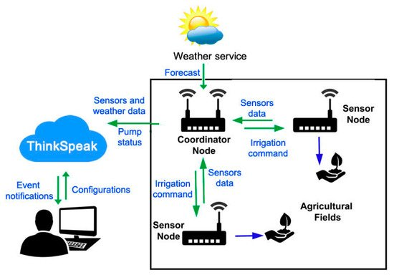
Project analysis slide 4
Project Analysis
The Composition of the system
The system is composed mainly of three parts:
Cloud Platform, Coordinator Node, and Sensor Nodes …

Slide 3
Project analysis slide 10
Project Analysis
Planning for first month
Week 1 6 Aug – 13 Aug | Week2 14 Aug – 20 Aug | Week3 21 Aug – 27 Aug | Week4 28 Aug – 3 Sep
Researching Code and test with dht11 Create charnel Thingspeak and testing. | To understand problem of code, Using Wi-Fi with username Combine code with coordinator and testing then send data to Thingspeak. | Collect data from Greenhouse send to Thingspeak And show all the result of Temperature (T1+T2) Or another Sensor on thingspeak. | Need to Complete planning of first month and continue working for second month to use Camera in greenhouse.
Missing: testing some error, problem to understand something in code | Not ready combine code with coordinator yet.

Slide 4
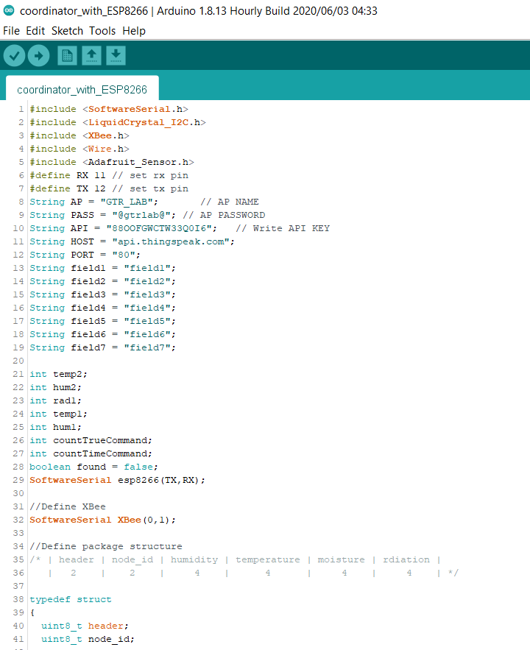
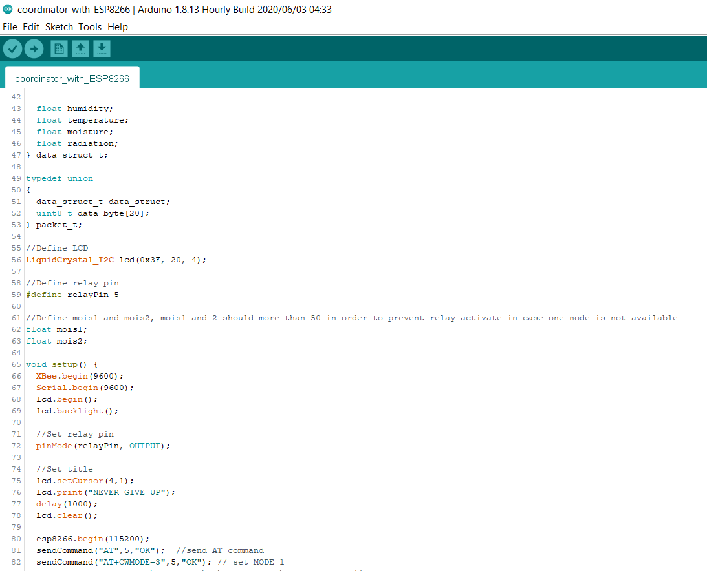
Project analysis slide 7
Project Analysis

Slide 5
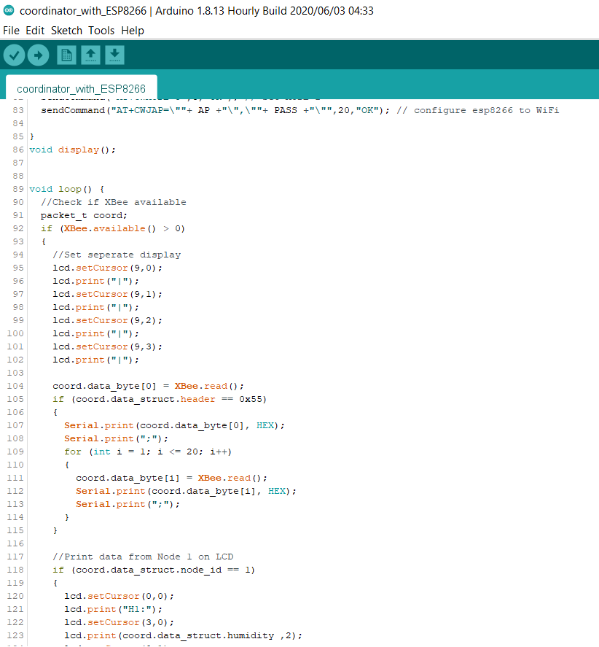
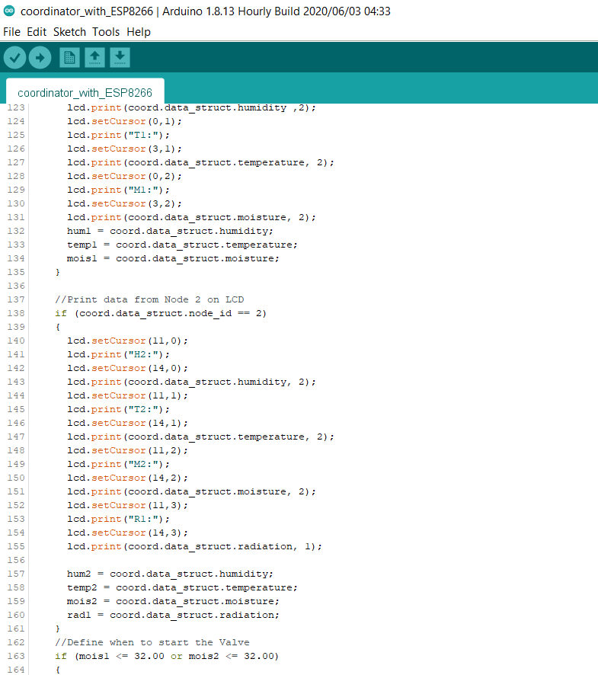
Project analysis slide 7
Project Analysis

Slide 6
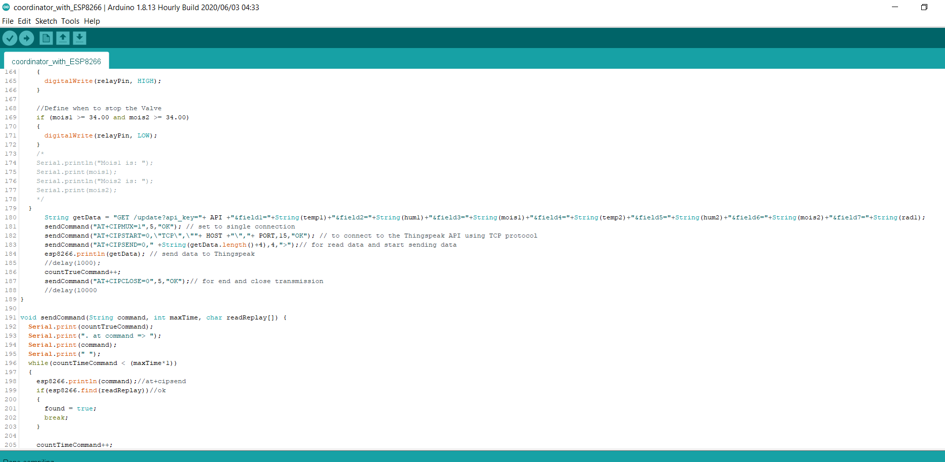
Project analysis slide 7
Project Analysis

Slide 7
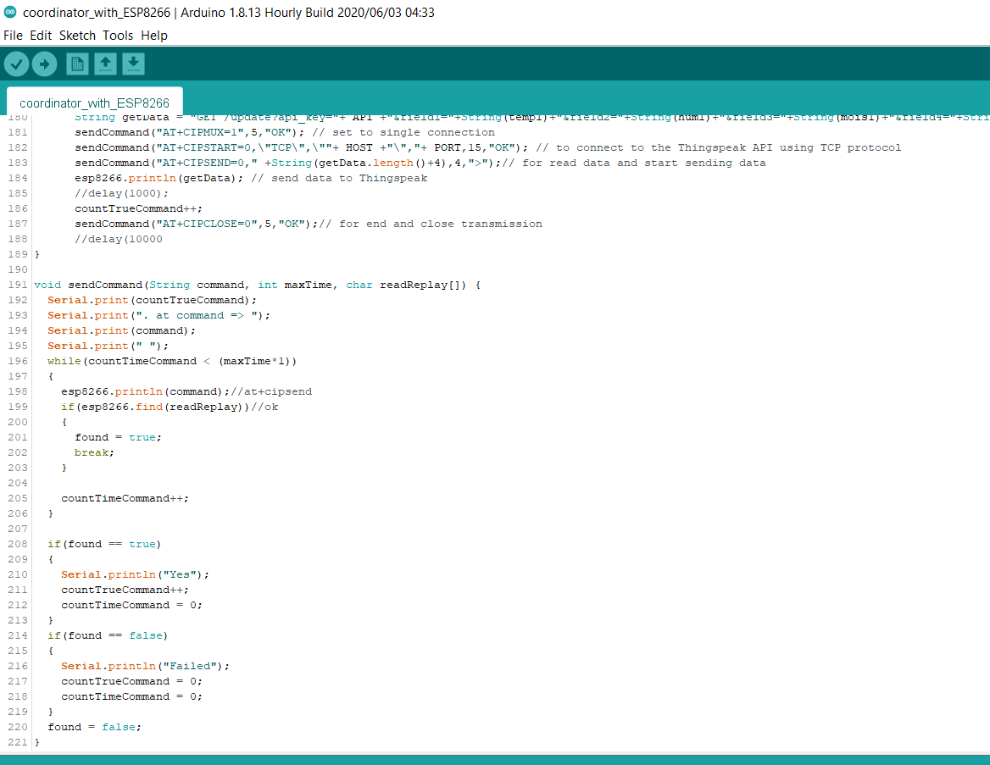
Project analysis slide 7
Project Analysis

Slide 8
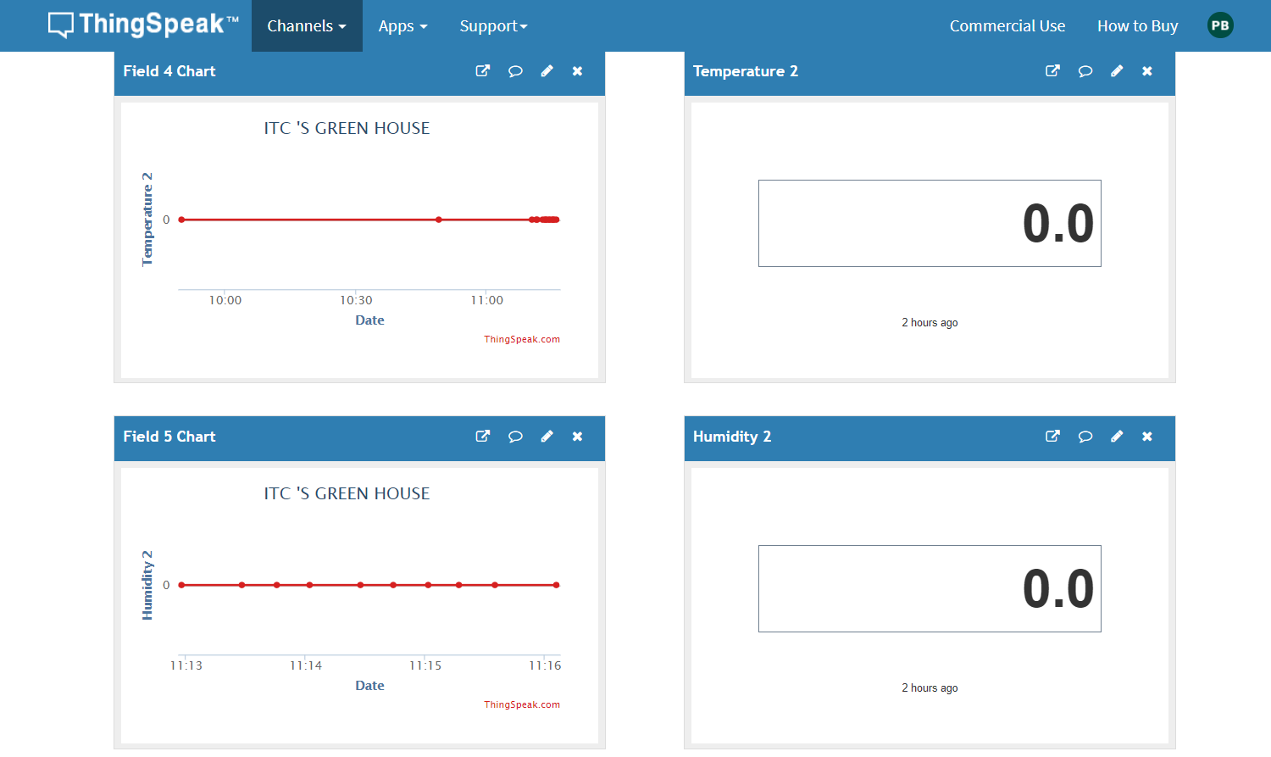
Project analysis slide 10
Project Analysis
Problems
Combine code not ready correct yet because send data to thingspeak value of dht not correct and lcd not print.

Slide 9
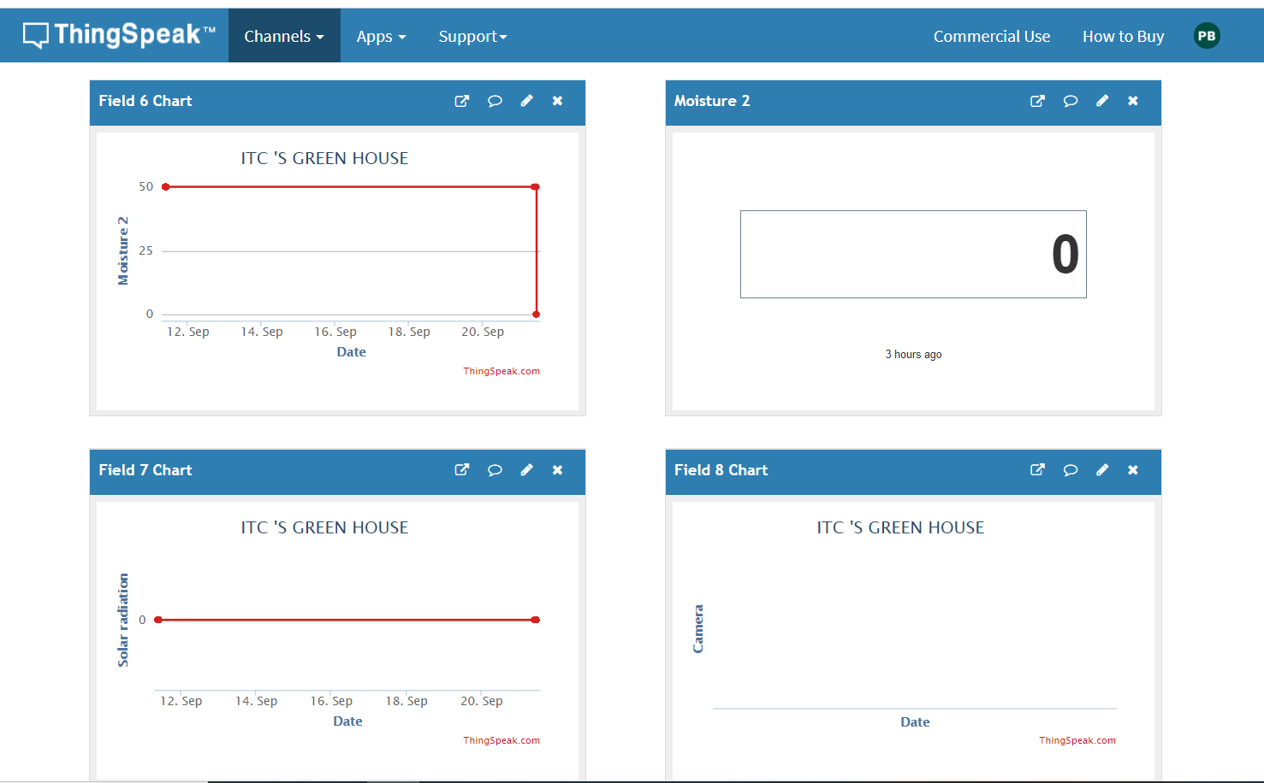
Project analysis slide 3
Project Analysis

Slide 10
Thank You

